Slide 1
Cloud Balancing Example: 2.1.8. KIE Server Integration
Source
https://docs.optaplanner.org/7.12.0.Final/optaplanner-wb-es-docs/html_single/

Slide 2
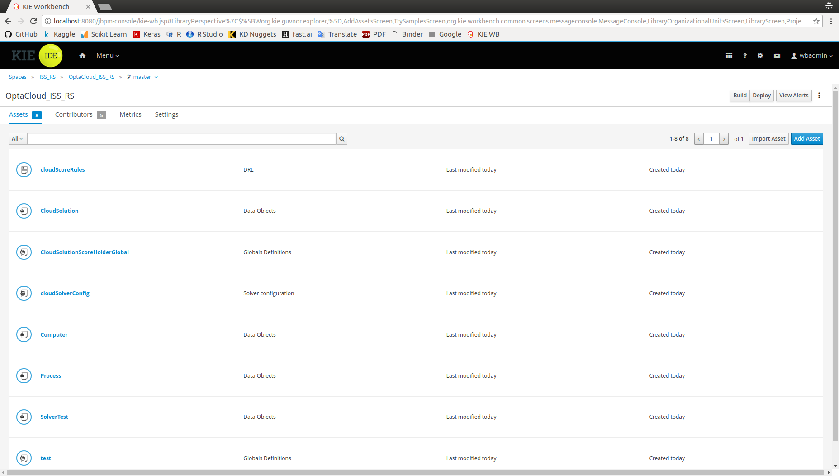

Slide 3
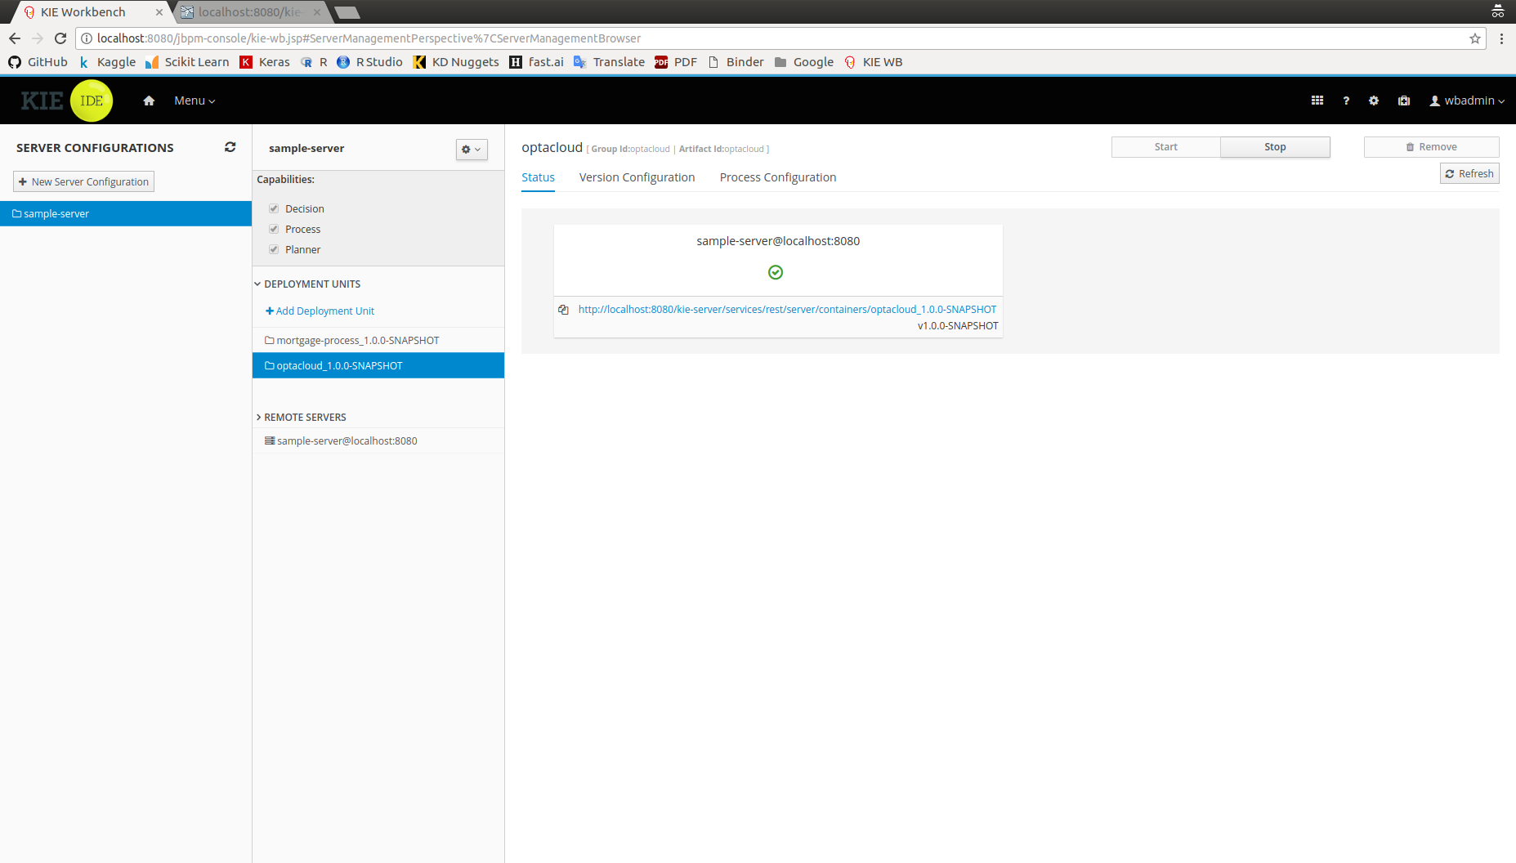

Slide 4
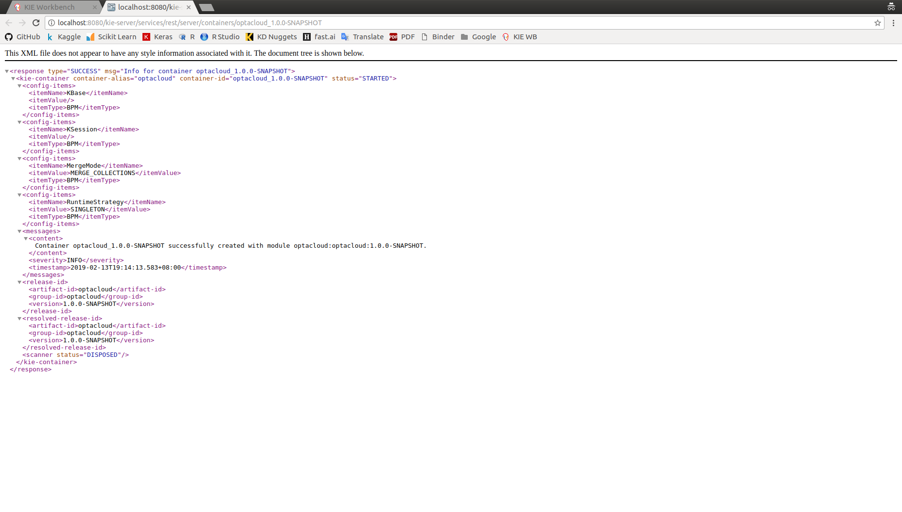

Slide 5

Restful API via Postman tool

Slide 6
PUT – Initiate a solver object/instance

Slide 7
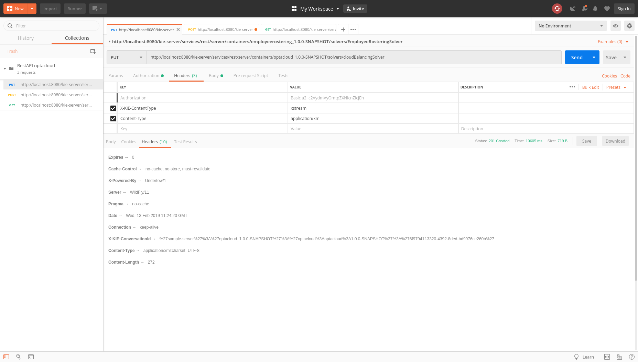

Slide 8
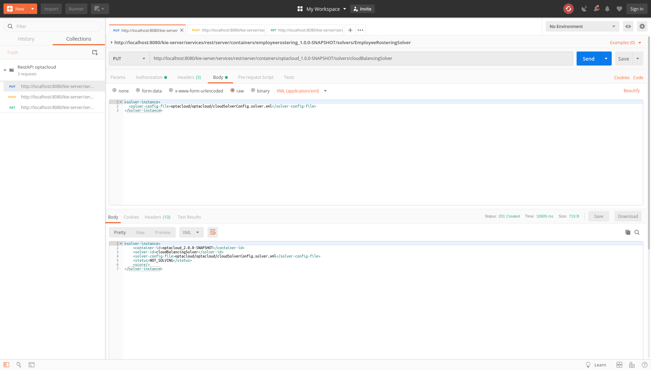

Slide 9
<solver-instance>
<solver-config-file>optacloud/optacloud/cloudSolverConfig.solver.xml</solver-config-file>
</solver-instance>

Slide 10
POST – Start the solver with biz context

Slide 11
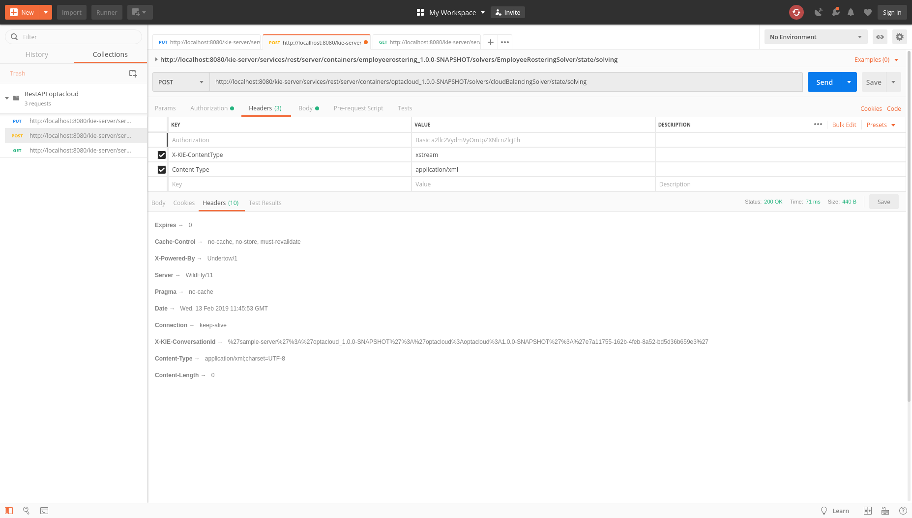

Slide 12
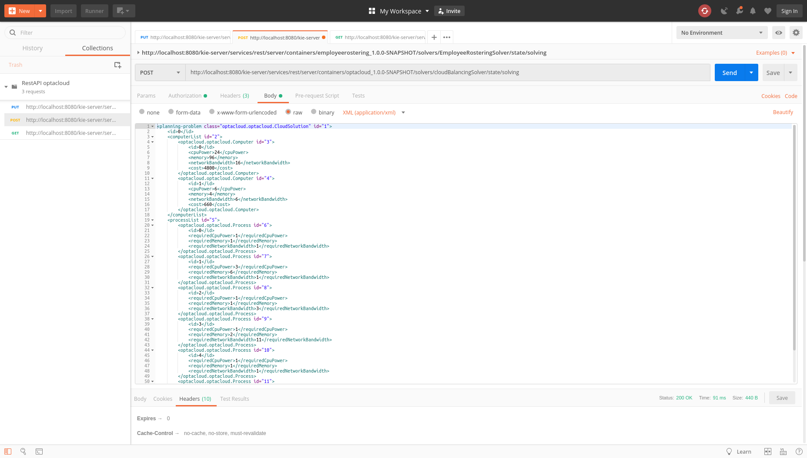

Slide 13
<planning-problem class="optacloud.optacloud.CloudSolution" id="1">
<id>0</id>
<computerList id="2">
<optacloud.optacloud.Computer id="3">
<id>0</id>
<cpuPower>24</cpuPower>
<memory>96</memory>
<networkBandwidth>16</networkBandwidth>
<cost>4800</cost>
</optacloud.optacloud.Computer>
<optacloud.optacloud.Computer id="4">
<id>1</id>
<cpuPower>6</cpuPower>
<memory>4</memory>
<networkBandwidth>6</networkBandwidth>
<cost>660</cost>
</optacloud.optacloud.Computer>
</computerList>
<processList id="5">
<optacloud.optacloud.Process id="6">
<id>0</id>
<requiredCpuPower>1</requiredCpuPower>
<requiredMemory>1</requiredMemory>
<requiredNetworkBandwidth>1</requiredNetworkBandwidth>
</optacloud.optacloud.Process>
<optacloud.optacloud.Process id="7">
<id>1</id>
<requiredCpuPower>3</requiredCpuPower>
<requiredMemory>6</requiredMemory>
<requiredNetworkBandwidth>1</requiredNetworkBandwidth>
</optacloud.optacloud.Process>
<optacloud.optacloud.Process id="8">
<id>2</id>
<requiredCpuPower>1</requiredCpuPower>
<requiredMemory>1</requiredMemory>
<requiredNetworkBandwidth>3</requiredNetworkBandwidth>
</optacloud.optacloud.Process>
<optacloud.optacloud.Process id="9">
<id>3</id>
<requiredCpuPower>1</requiredCpuPower>
<requiredMemory>2</requiredMemory>
<requiredNetworkBandwidth>11</requiredNetworkBandwidth>
</optacloud.optacloud.Process>
<optacloud.optacloud.Process id="10">
<id>4</id>
<requiredCpuPower>1</requiredCpuPower>
<requiredMemory>1</requiredMemory>
<requiredNetworkBandwidth>1</requiredNetworkBandwidth>
</optacloud.optacloud.Process>
<optacloud.optacloud.Process id="11">
<id>5</id>
<requiredCpuPower>1</requiredCpuPower>
<requiredMemory>1</requiredMemory>
<requiredNetworkBandwidth>5</requiredNetworkBandwidth>
</optacloud.optacloud.Process>
</processList>
</planning-problem>

Slide 14
GET – Obtain best solution (xml)

Slide 15
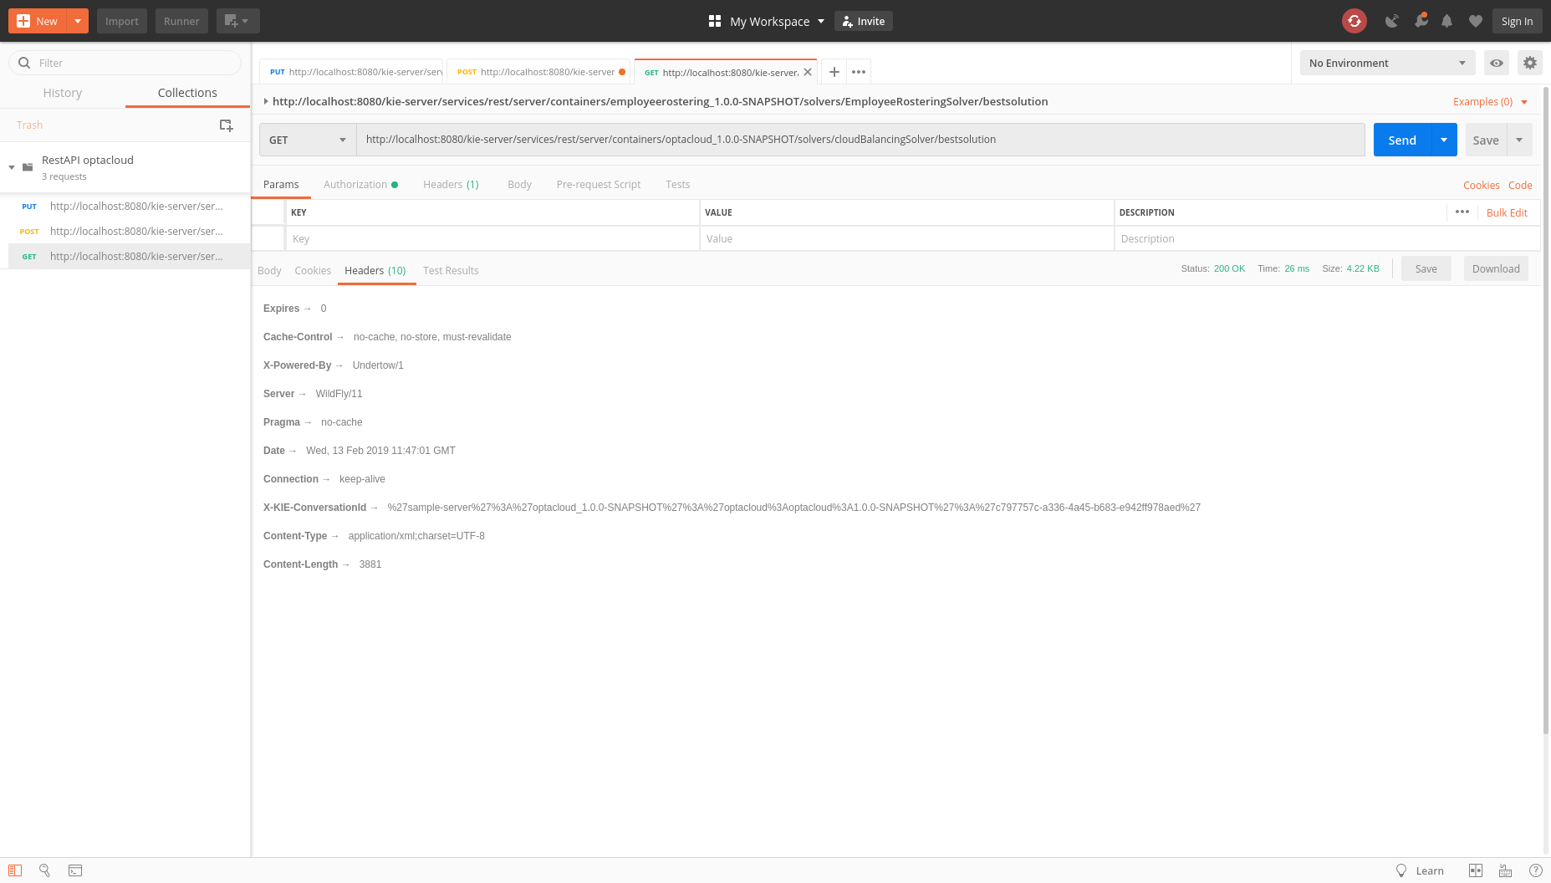

Slide 16
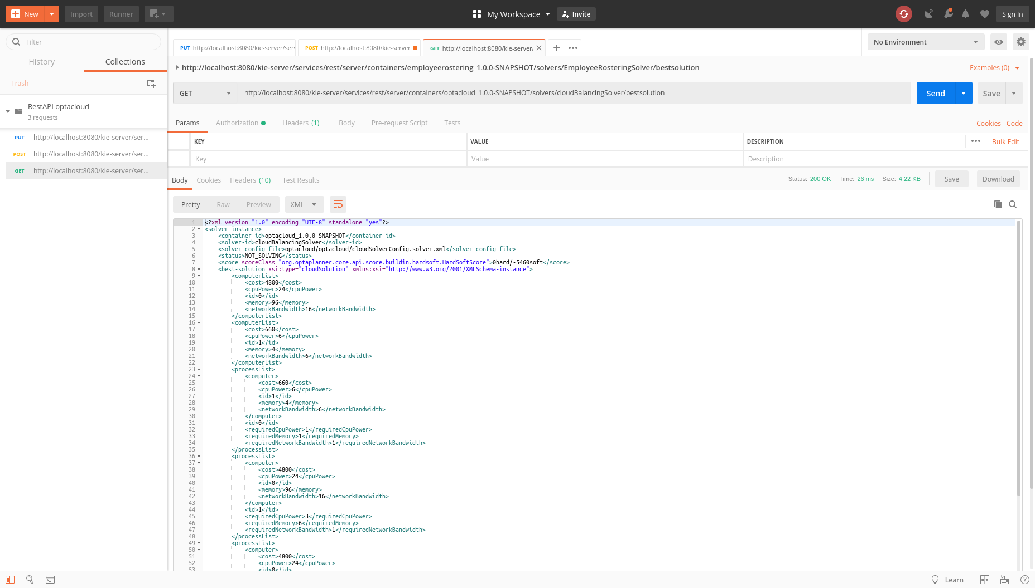

Slide 17
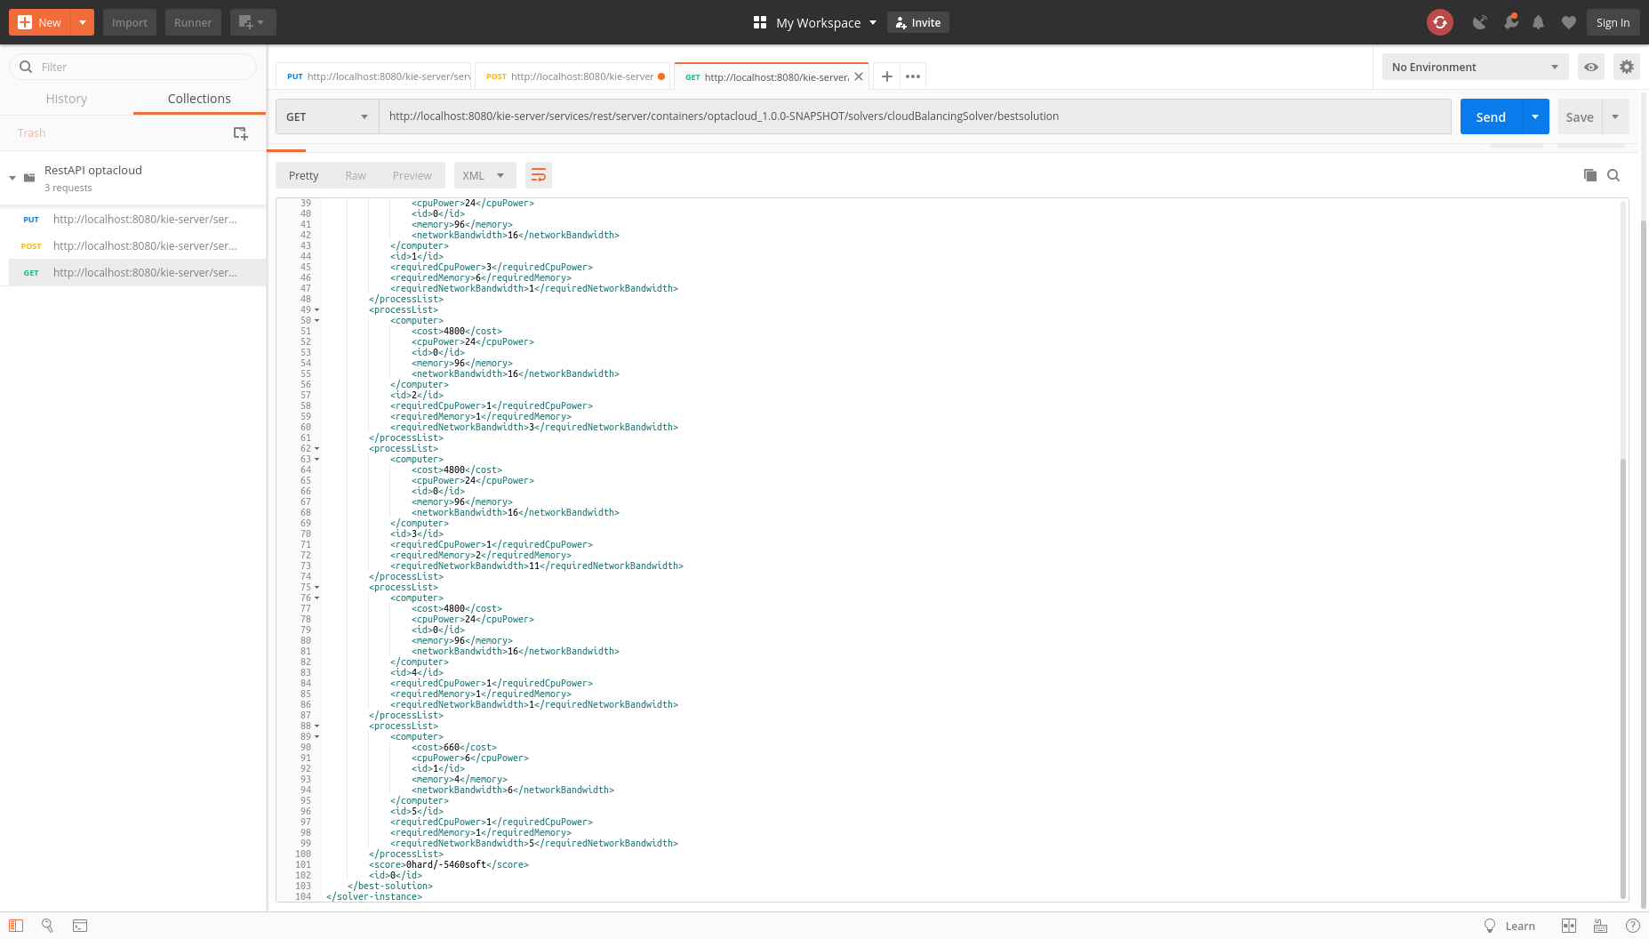

Slide 18
<?xml version="1.0" encoding="UTF-8" standalone="yes"?>
<solver-instance>
<container-id>optacloud_1.0.0-SNAPSHOT</container-id>
<solver-id>cloudBalancingSolver</solver-id>
<solver-config-file>optacloud/optacloud/cloudSolverConfig.solver.xml</solver-config-file>
<status>NOT_SOLVING</status>
<score scoreClass="org.optaplanner.core.api.score.buildin.hardsoft.HardSoftScore">0hard/-5460soft</score>
<best-solution xsi:type="cloudSolution" xmlns:xsi="http://www.w3.org/2001/XMLSchema-instance">
<computerList>
<cost>4800</cost>
<cpuPower>24</cpuPower>
<id>0</id>
<memory>96</memory>
<networkBandwidth>16</networkBandwidth>
</computerList>
<computerList>
<cost>660</cost>
<cpuPower>6</cpuPower>
<id>1</id>
<memory>4</memory>
<networkBandwidth>6</networkBandwidth>
</computerList>
<processList>
<computer>
<cost>660</cost>
<cpuPower>6</cpuPower>
<id>1</id>
<memory>4</memory>
<networkBandwidth>6</networkBandwidth>
</computer>
<id>0</id>
<requiredCpuPower>1</requiredCpuPower>
<requiredMemory>1</requiredMemory>
<requiredNetworkBandwidth>1</requiredNetworkBandwidth>
</processList>
<processList>
<computer>
<cost>4800</cost>
<cpuPower>24</cpuPower>
<id>0</id>
<memory>96</memory>
<networkBandwidth>16</networkBandwidth>
</computer>
<id>1</id>
<requiredCpuPower>3</requiredCpuPower>
<requiredMemory>6</requiredMemory>
<requiredNetworkBandwidth>1</requiredNetworkBandwidth>
</processList>
<processList>
<computer>
<cost>4800</cost>
<cpuPower>24</cpuPower>
<id>0</id>
<memory>96</memory>
<networkBandwidth>16</networkBandwidth>
</computer>
<id>2</id>
<requiredCpuPower>1</requiredCpuPower>
<requiredMemory>1</requiredMemory>
<requiredNetworkBandwidth>3</requiredNetworkBandwidth>
</processList>
<processList>
<computer>
<cost>4800</cost>
<cpuPower>24</cpuPower>
<id>0</id>
<memory>96</memory>
<networkBandwidth>16</networkBandwidth>
</computer>
<id>3</id>
<requiredCpuPower>1</requiredCpuPower>
<requiredMemory>2</requiredMemory>
<requiredNetworkBandwidth>11</requiredNetworkBandwidth>
</processList>
<processList>
<computer>
<cost>4800</cost>
<cpuPower>24</cpuPower>
<id>0</id>
<memory>96</memory>
<networkBandwidth>16</networkBandwidth>
</computer>
<id>4</id>
<requiredCpuPower>1</requiredCpuPower>
<requiredMemory>1</requiredMemory>
<requiredNetworkBandwidth>1</requiredNetworkBandwidth>
</processList>
<processList>
<computer>
<cost>660</cost>
<cpuPower>6</cpuPower>
<id>1</id>
<memory>4</memory>
<networkBandwidth>6</networkBandwidth>
</computer>
<id>5</id>
<requiredCpuPower>1</requiredCpuPower>
<requiredMemory>1</requiredMemory>
<requiredNetworkBandwidth>5</requiredNetworkBandwidth>
</processList>
<score>0hard/-5460soft</score>
<id>0</id>
</best-solution>
</solver-instance>

Slide 19
Download optimized result in XML

